Slide 1
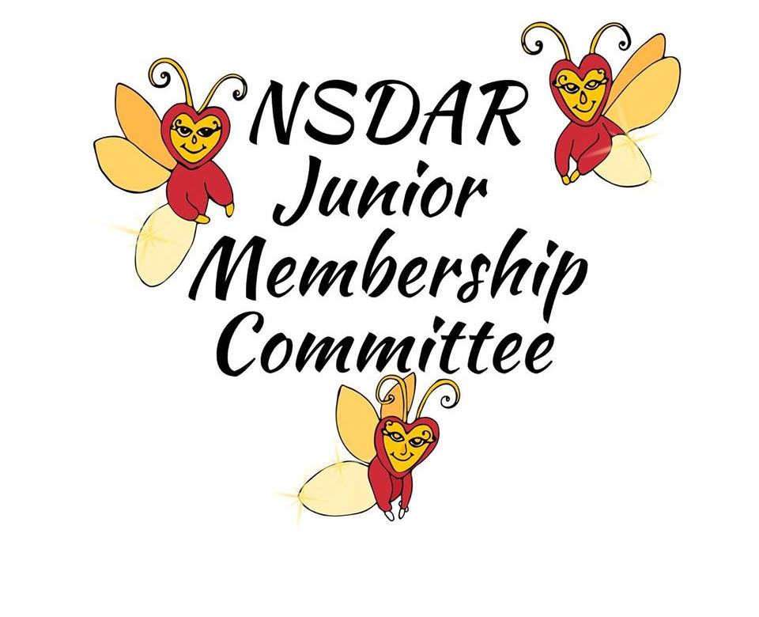
2022 Helen Pouch Memorial Fund
Classroom Grant Program
Two grants of $500 each for two classrooms in each state
and the District of Columbia (totaling $51,000).
Classroom teachers for grades kindergarten through 12th grade
are eligible to apply.
Deadline for applying is May 1, 2022
Contact your State Junior Membership Chair
for details and the application
Made possible through the DAR National Junior Membership Committee
and the Helen Pouch Memorial Fund

